Slide 1


Social data mining techniques
Assignment 1
date
10/07/2020
created by
Monil Modi, Ashish Pandey, Sonali Jain, Deepali Sharma, Sudipa Nag

Slide 2
About Us
Discover Trending Board Games on Board Games Portal
Board Games Portal is an online board gaming resource and community. The site is most up-to-date place to get gaming information! You are certainly encouraged to help improve the site by adding your own board games and updating the existing board games. You can also View the List of all Board Games, View individual board game details, Delete Board Games
Board Games Data has been fetched using Board Games Atlas API

Slide 3



Team Members :
Monil Mayur Modi
200460907
Ashish Pandey
200457900
Sonali Jain
200455424
Developer
Developer
Quality Assurance
Bachelor’s of Science in Information and technology
(B.Sc. I.T)
Bachelor’s of Science in Information and technology
(B.Sc. I.T)
Bachelor’s of Information and Communication Technology
(B.E. I.C.T)

Slide 4
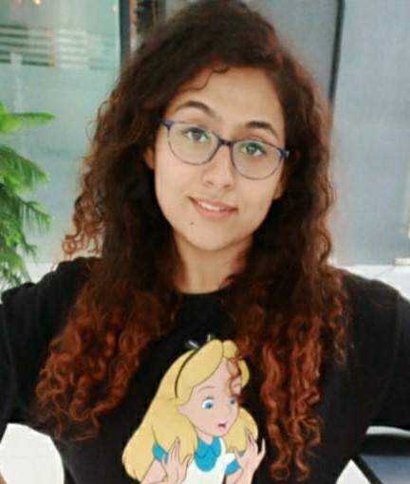

Team Members :
Deepali Sharma
200457502
Sudipa Nag
200462845
Database Administrator
Business Analyst
Bachelor’s in Electronics and Telecommunications
Bachelor’s in Electronics and Telecommunications

Slide 5
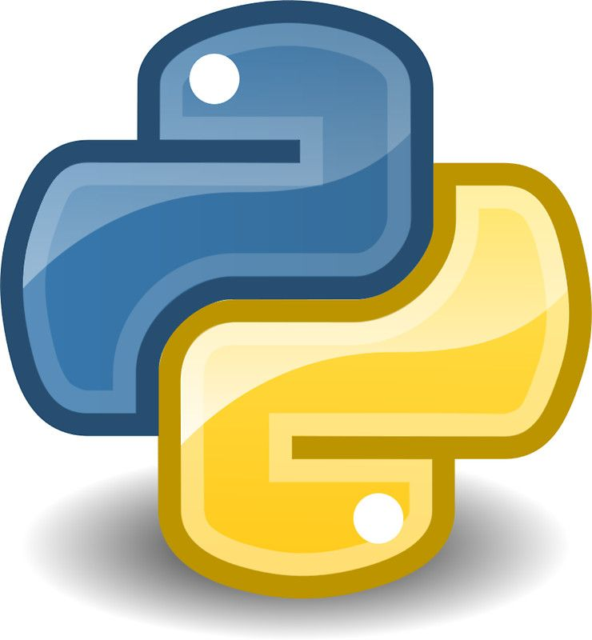



Technology Used :
Python:
Mongo DB:
Python is a general-purpose programming language. It is used in this project to fetch data from the source and then to load them to database.
MongoDB is a cross-platform document-oriented database program. Use of Mongo db is to store the fetched data into the cloud storage.
Flask:
HTML and CSS:
Flask is a micro web framework written in Python. It is used to develop front end of the project.
HTML stands for Hypertext markup language & CSS stands for Cascading style sheets is used for beautification of the website.

Slide 6

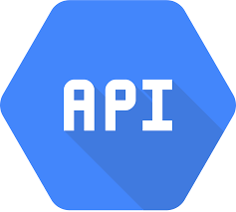
Workflow :
Used python for scripting to fetch data from board game atlas API
Used Flask to perform CRUD functionalities on the data.
Step 2: Fetch data from API
Step 4: Working with data
Step 1: Find Data source
Step 3: Cloud data storage
Step 5: Developing Web Application
Used board games atlas API to gather data.
Used Mongo DB Cloud to store the data.
Used HTML and CSS to develop the front end for flask.

Slide 7

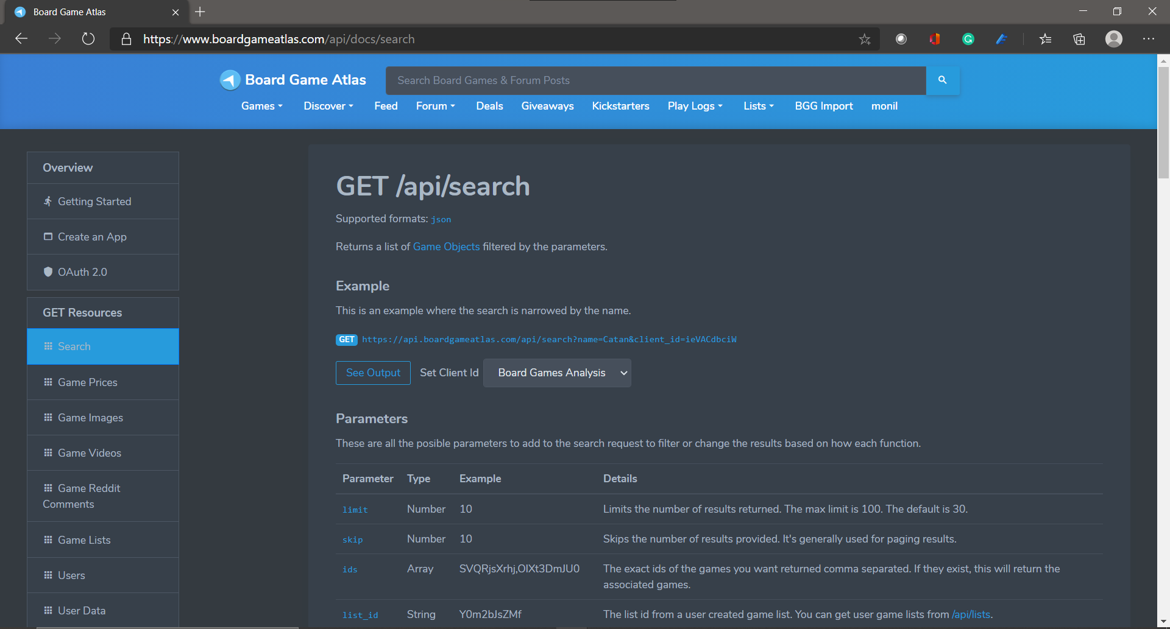
Data Source : Board Game Atlas API

Slide 8
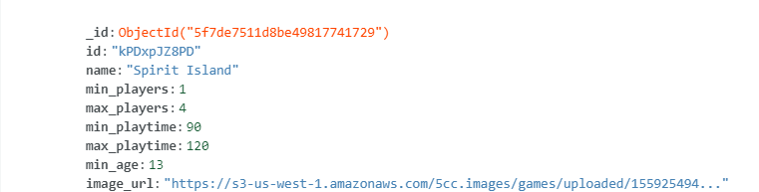
Data Structure :

Slide 9
Data Description :
Fields | Description
Name | Name of the boardgame
Image URL | Image URL of the boardgame
Min players | Minimum players required to play the game
Max players | Maximum players required to play the game
Min playtime | Minimum playtime to complete the game
Max playtime | Maximum playtime to complete the game
Min Age | Minimum legal Age to play the game

Slide 10
Site Map :
Application
fetchData.py
App.py
Index.html
List.html
Update.html
Landing Page
Create, Read, Delete
Update

Slide 11
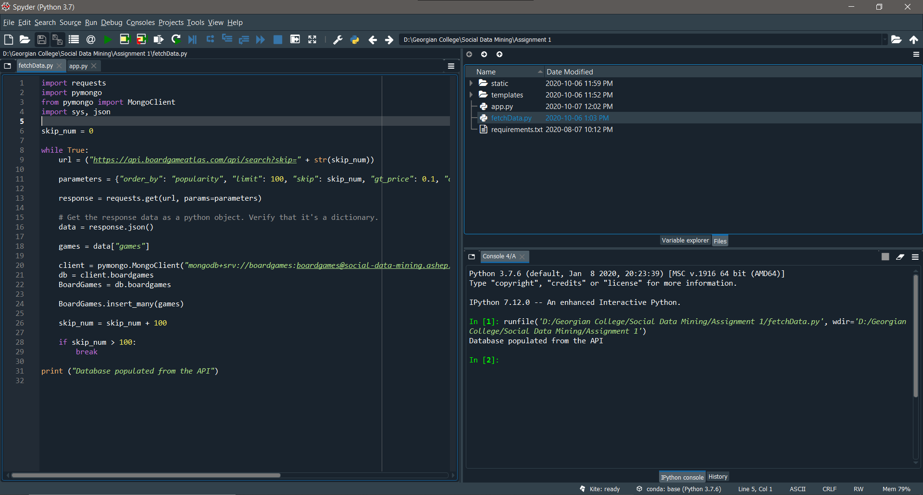
Code Snippet : fetchData.py (Get Data from API)

Slide 12
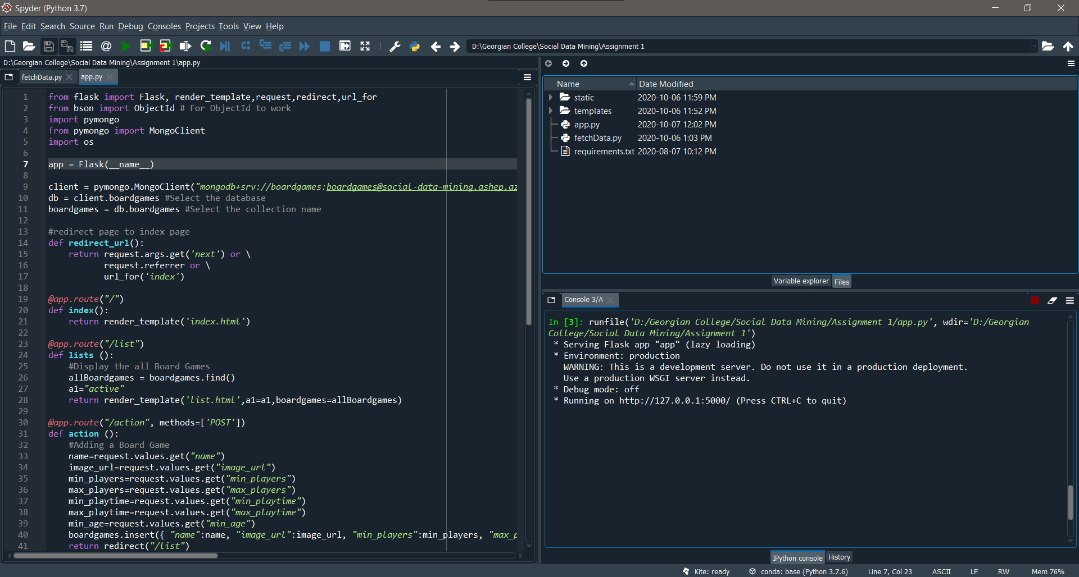
Code Snippet : app.py (Flask CRUD App)

Slide 13
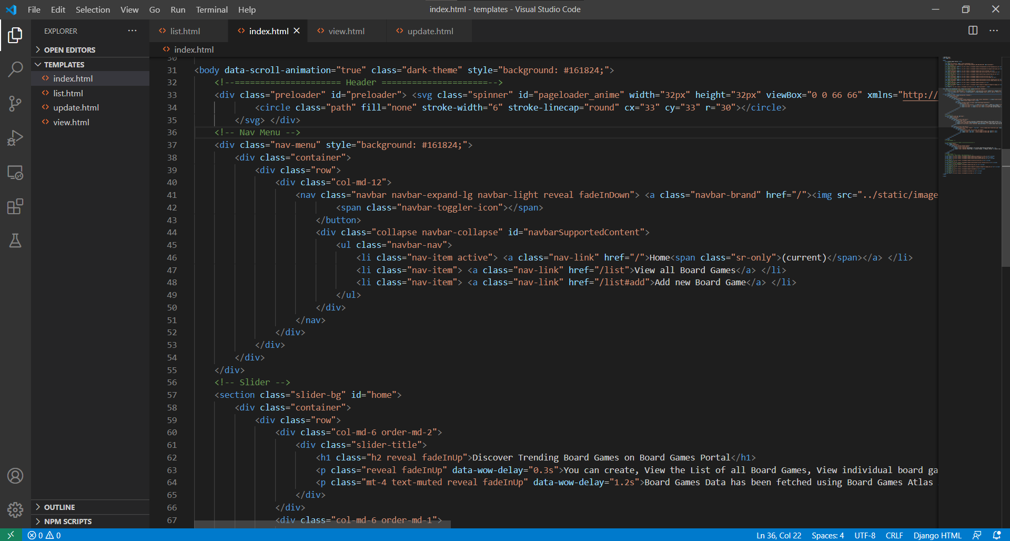
Code Snippet : index.html (Landing Page)

Slide 14
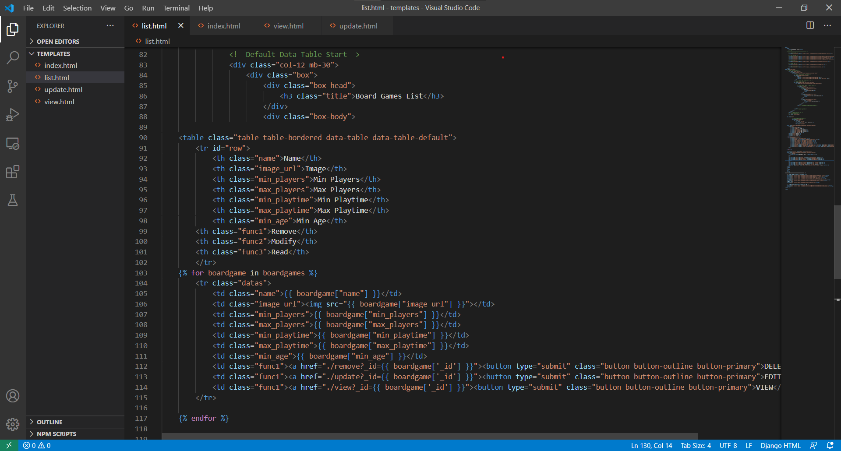
Code Snippet : list.html (List of All Board Games)

Slide 15
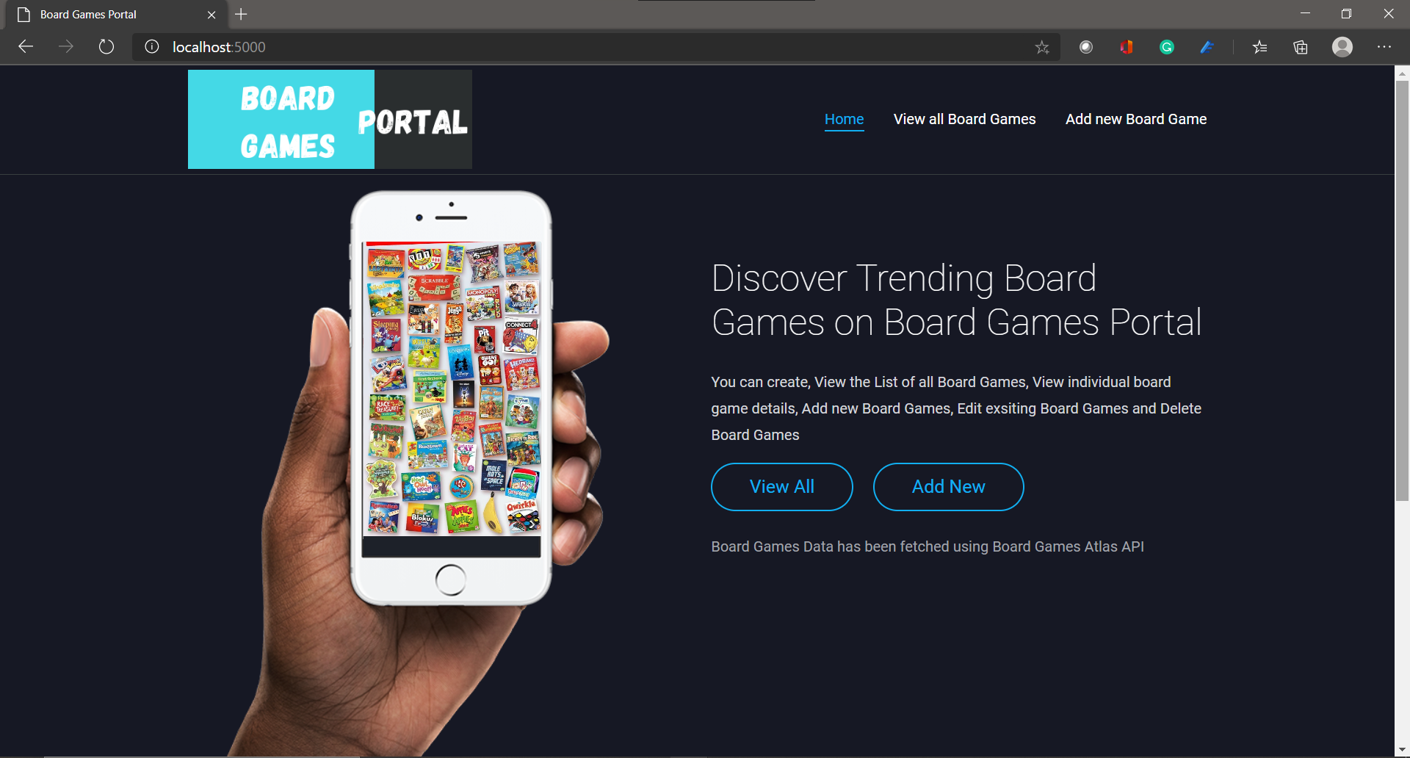
Application Screenshot : Landing Page

Slide 16
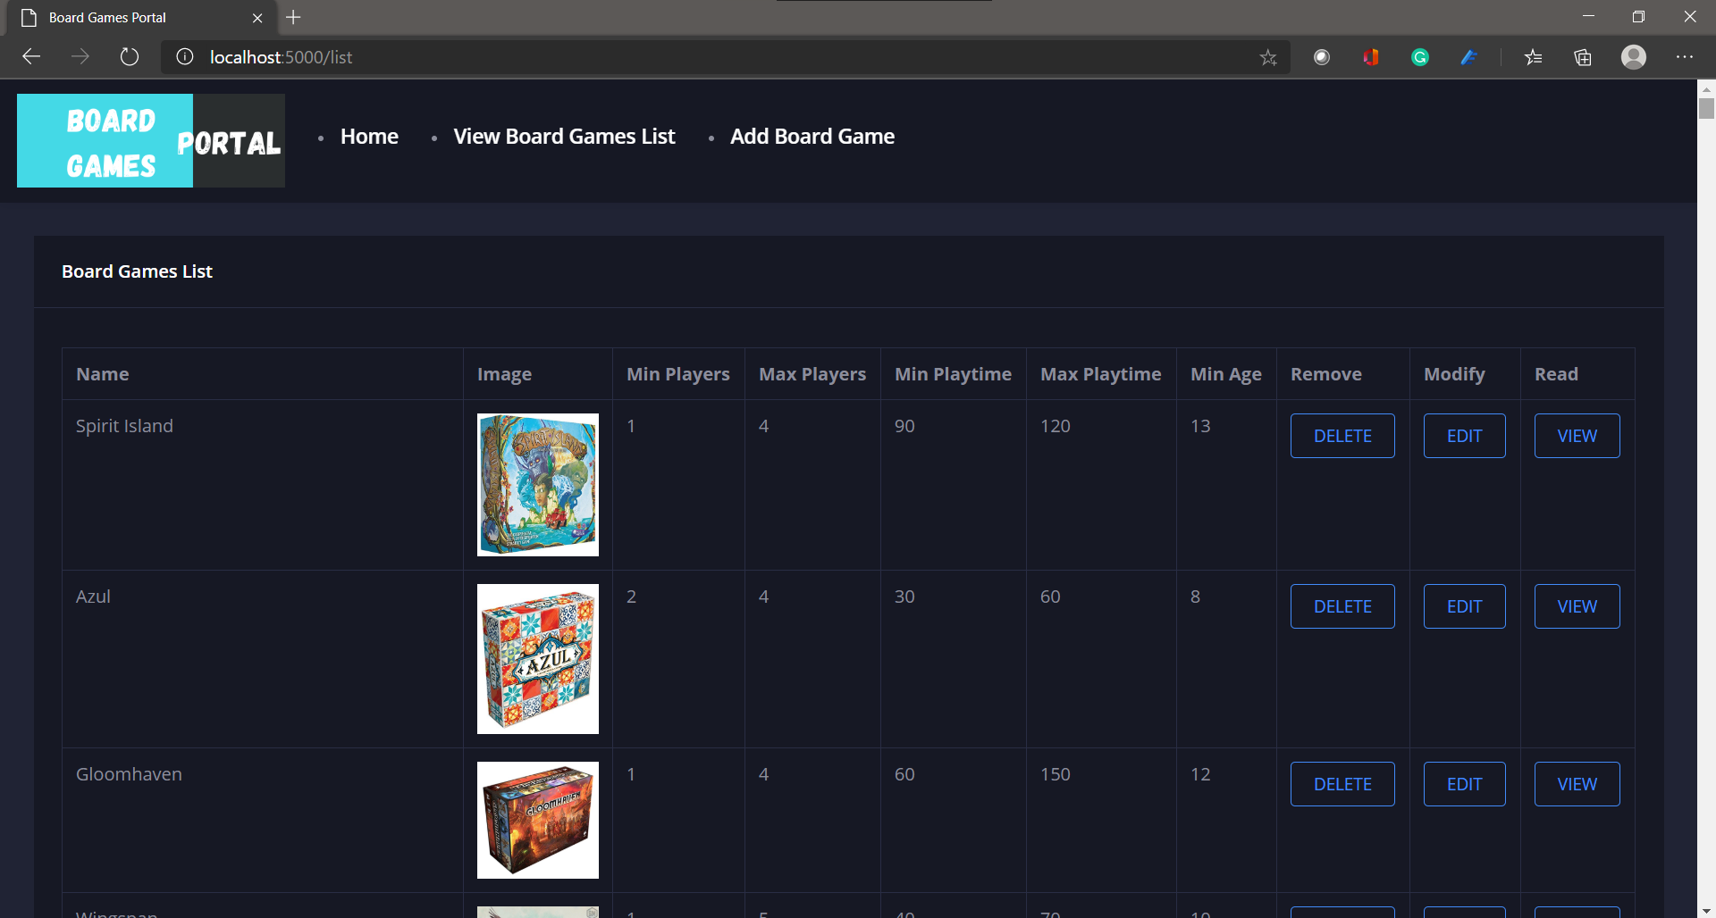
Application Screenshot : List All
1
2
DELETE : Deleting Records
EDIT : Updating the records
VIEW: Read individual records
3

Slide 17

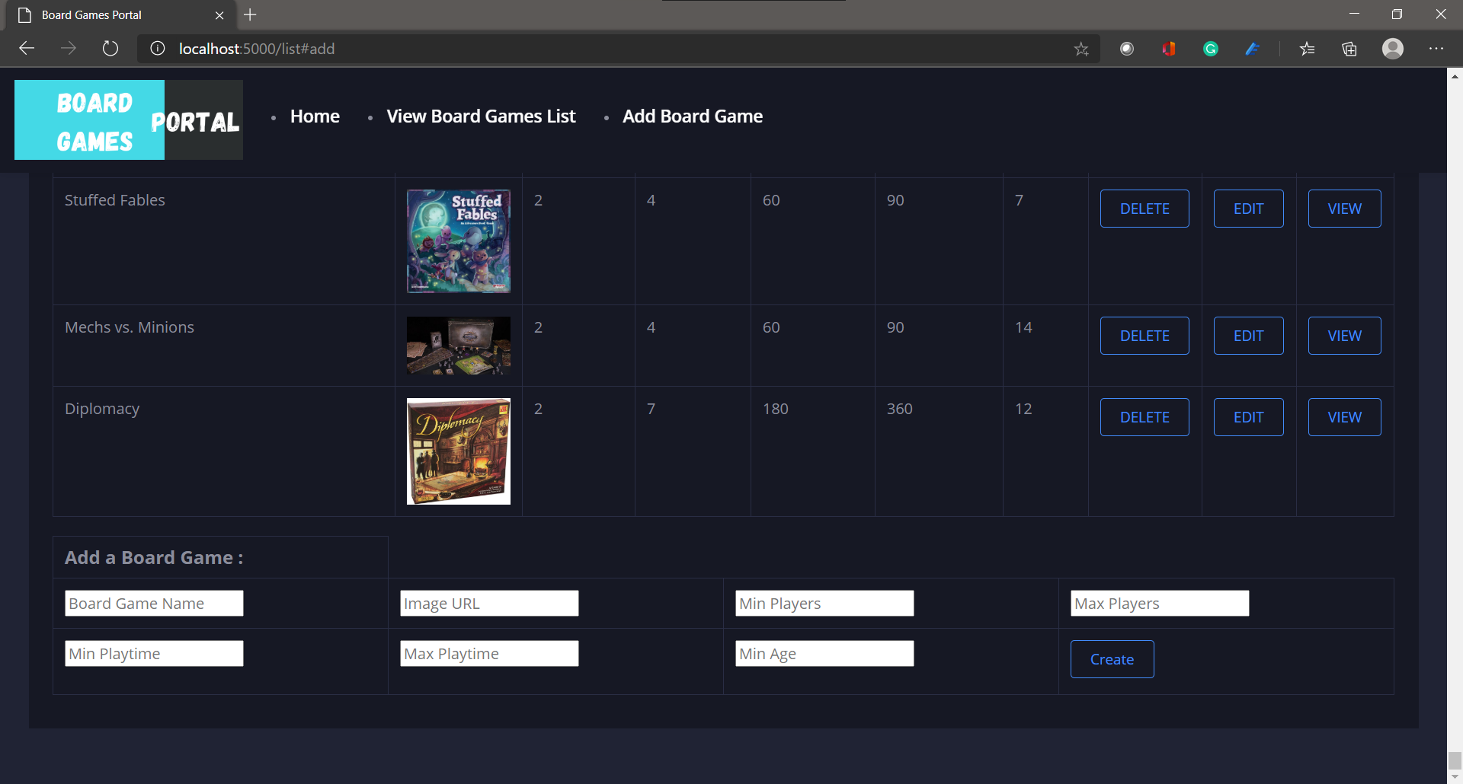
Application Screenshot : Add New Board Game

Slide 18
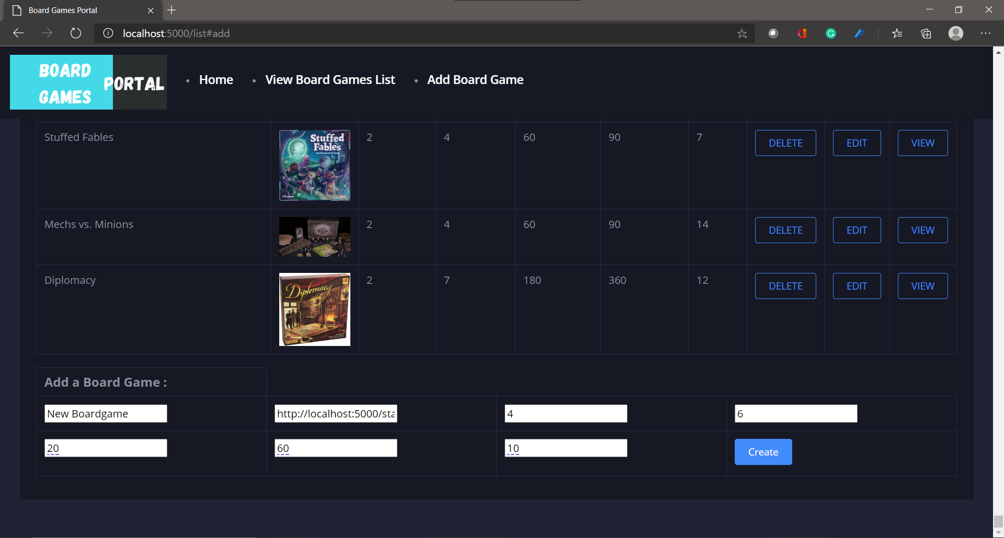
Application Screenshot : Add New Board Game

Slide 19
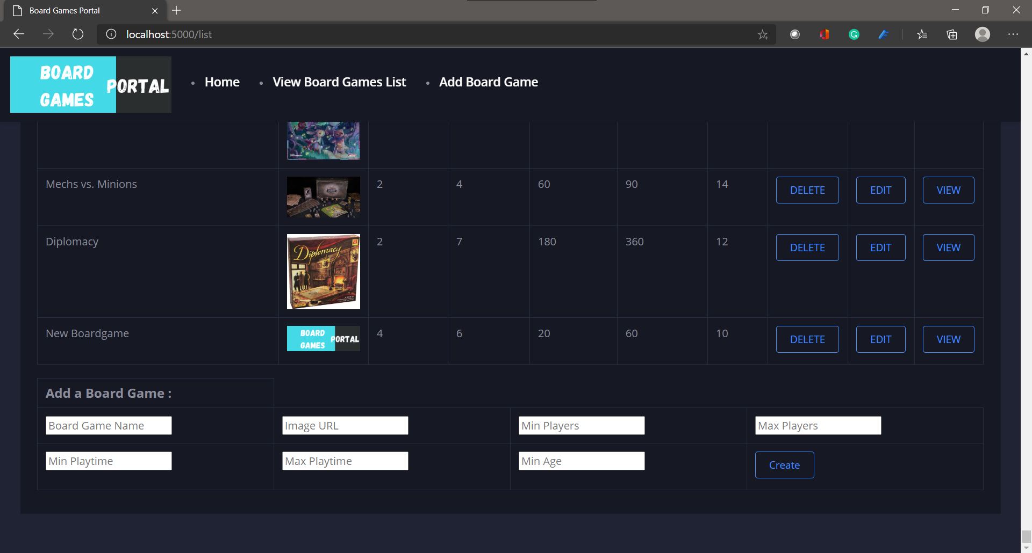
Application Screenshot : New Board Game Added
1
New Record added

Slide 20
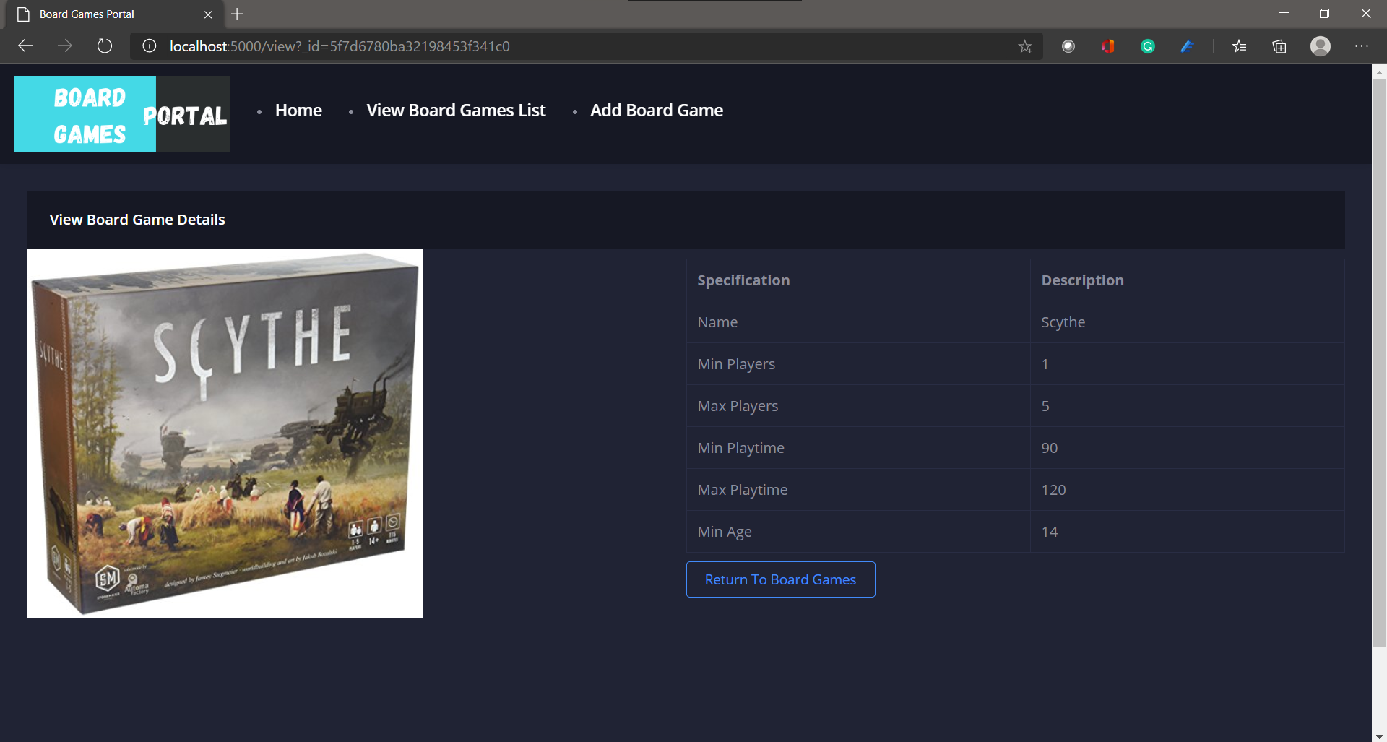
Application Screenshot : View Single Board Game

Slide 21
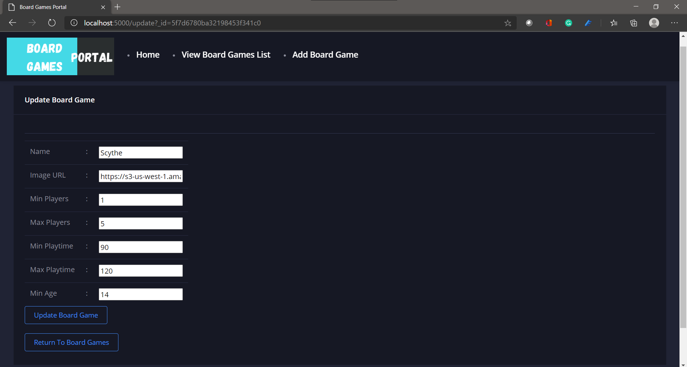
Application Screenshot : Updating Single Board Game

Slide 22
Thank you !

